Slide 1
BrightTV (Viewership Analytics)
By Steve Odhiambo

Slide 2
Methodology
To evaluate and analyze the viewership patterns of BrightTV, a structured data collection, transformation, and analysis approach was adopted.

Slide 3
Data Collection and Storage
Data was gathered from two primary sources:
User Profile Sheet:
Containing demographic and personal information such as UserID, Name, Surname, Email, Gender,
Race, Age, Province, and Social Media Handle.
Viewership Sheet:
Containing user engagement data including UserID, RecordDate2, and Duration 2 (viewing time).
These datasets were uploaded into Microsoft SQL Server for secure storage and structured querying.

Slide 4
Data Integration
To enable meaningful analysis; the two datasets were integrated using the UserID field as a common key.
An INNER JOIN was performed between the User Profile and Viewership tables.
This ensured that only users with corresponding entries in both datasets were included in the final dataset for analysis.

Slide 5
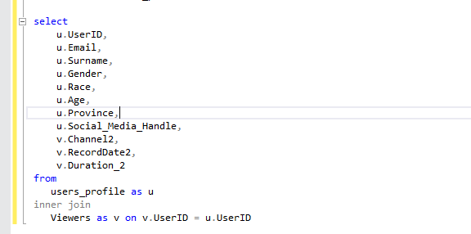
Inner Join query

Slide 6
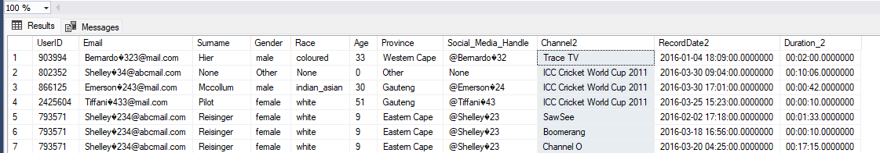
Inner join Table

Slide 7
Data Cleaning and Preparation
Data was cleaned to ensure consistency and accuracy:
Removed duplicates and null entries.
Standardized date and time formats.
Ensured demographic fields (e.g., Gender, Province) had consistent values.

Slide 8
Data Analysis
Various analytical techniques were employed to uncover trends and insights:
Demographic Analysis: Viewership patterns were segmented by age, gender, race, and province.
Temporal Analysis: Viewership duration was analyzed across different dates to identify peak viewing times and trends.
Engagement Metrics: Average viewing duration per user and per demographic group was calculated.

Slide 9
Data Visualization
Insights were visualized using Microsoft Excel:
Bar charts and pie charts to show demographic distributions.
Line graphs to display trends in viewership over time.
Heatmaps to highlight high and low engagement periods.
These visualizations enabled clear communication of insights to stakeholders and guided data-driven decisions for BrightTV.

Slide 10
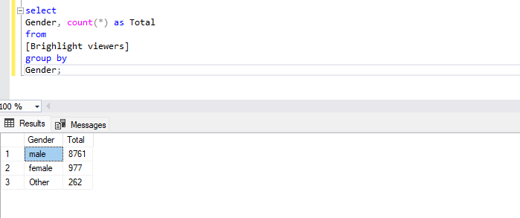
Descriptive Analysis
Count of users by gender

Slide 11
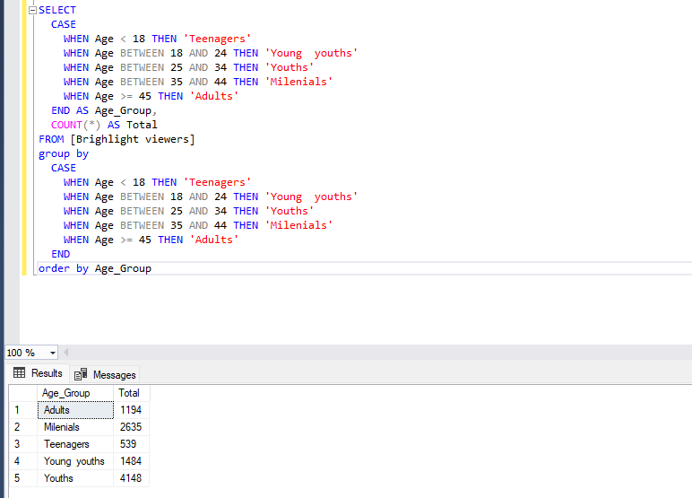
Age Distribution (Grouped):

Slide 12
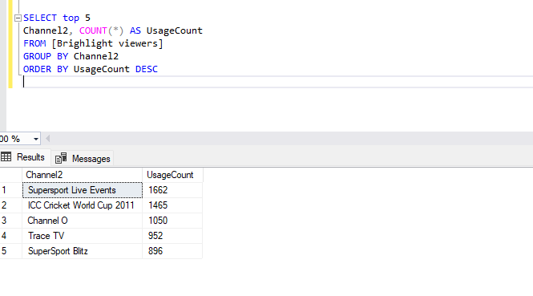
Top 5 Most Used Channels:

Slide 13
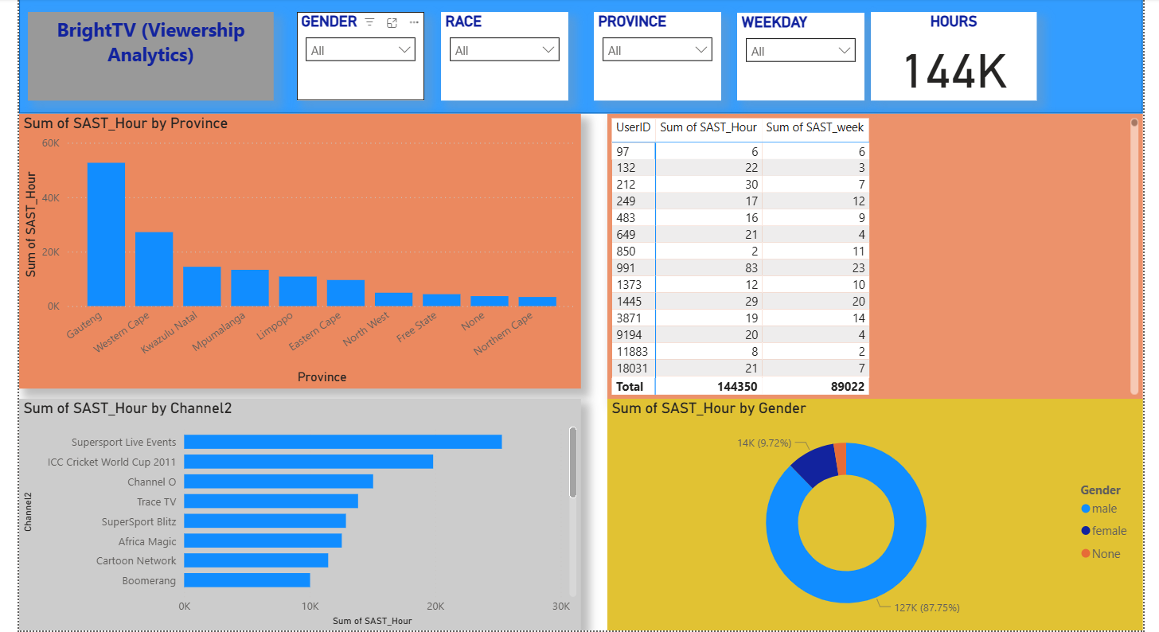
Visualization

